Slide 1

State of Texas Electronic and Information Resources (EIR) Accessibility
Contract & Procurement Training
AccessU Conference Wednesday, May 15, 2013
Ron Lucey & Adrian R. Pineda, CTCM, CTPM
Department of Assistive & Rehabilitative Services (DARS)
Notes:
[Welcome] Adrian
[Announcements, if any]
The first handout in your packet is the training slides we will be reviewing today.

Slide 2
Learning objectives
After taking this training, you will:
  understand Electronic and Information Resources (EIR) accessibility laws, regulations, and impact
  know how to assess accessibility in solicitation responses
  understand vendor responsibilities
  know how to analyze a Voluntary Product Accessibility Template (VPAT)
  understand how accessibility is integrated into the procurement process and contracting life cycle
  know how to assess accessibility in solicitation responses
Notes:
Adrian
Ron does the next slide

Slide 3
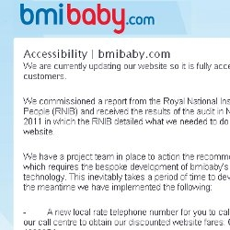





Accessibility-related Litigation and Legal Inquiries
The Royal National Institute of Blind People (RNIB) entered legal proceedings against airline for failing to make its website accessible to the blind / partially-sighted.
Sued by NFB & ACB for use of Kindle DX for ebooks; complaints also filed with US DoE and DoJ on Case Western Reserve, University of Virginia, Pace University, Princeton University, and Reed College. Settled.
Will pay up to $16 million to compensate individuals who experienced discrimination in violation of Title III of the Americans with Disabilities Act (ADA)
Sued by NFB for inaccessible website. Settlement of $6M not including legal expenses, site remediation, and other incidentals.
Major tech company and State of Texas sued by NFB – Software is inaccessible to blind State of Texas employees.
PMI (US-based organization) sued in UK because of inaccessible training application.
Sued by Dept. of Justice for ADA violations. Settlement terms: must provide accommodations for deaf and hard of hearing students.
Fined by State of New York for special pricing available only on inaccessible websites.
Sued by NFB and state employees because web applications were
inaccessible to the blind. Settled.
Sued by individuals. Inaccessible online services included in ruling.
Notes:
Ron Does this slide.
Ron does the next slide

Slide 4
EIR Accessibility
State agencies must provide comparable access to information resources to both employees and the public with and without disabilities:
Americans with Disabilities Act of 1973, Titles 1 and 2
Rehabilitation Act of 1973, Section 508
Government Code, Chapter 2054, Subchapter M and
1 Texas Administrative Code, Chapters 206 and 213
Examples of electronic and information resources:
telephones & telephone systems computers
websites/electronic documents videos
copiers & multi-function copiers fax machines
Employees should design such electronic information as emails, spreadsheets, Word documents, and PDFs using accessibility guidelines.
Notes:
Ron does this slide: After the first paragraph: You will encounter vendors who will use the term section 508. The basis for the Texas Administrative Code chapters listed here is section 508; the two are equivalent.
After the first paragraph: Electronic and information resources includes information technology and any equipment or interconnected system or subsystem of equipment, that is used in the creation, conversion duplication, or delivery of data or information. Basically that means anything that is created, stored, or sent digitally.
Ron does the next slide

Slide 5
EIR Accessibility, cont’d.
Title I of the ADA prohibits employers from discriminating against qualified job applicants and employees with disabilities. It further requires that employers make reasonable accommodations for employees with disabilities, including access to information and technology resources.
Title II of the ADA requires all state and local government to take steps to ensure that their communications with people with disabilities are as effective as communications with others, and requires state and local government agencies to provide equal access to programs and services, unless doing so would fundamentally alter the nature of the programs and services. This includes making agency web sites, electronic documents, software applications, and other technology resources accessible.
Notes:
Ron does this slide:
Adrian does the next slide:

Slide 6

Accessibility in Procurement
Goals:
to purchase products and services with maximum accessibility
to ensure effective and efficient access to EIR
to comply with federal, state, and agency EIR Accessibility policies
  Compliance is a primary selection factor.
  Compliance must be verified.
  Vendors may need accessibility training.
    HHS website (http://hhscx.hhsc.state.tx.us/EIR/)
    Knowbility (http://www.knowbility.org/main/)
    EASI (http://easi.cc)
    WebAIM (http://www.webaim.org)
    DIR (www.dir.texas.gov)
Notes:
Adrian does this slide: first bullet: The majority of products are not completely accessible.
After second bullet: This means comparable in quality, timeliness of delivery and availability.
After bullet 3, before the last sub-bullet: Texas and 20 other states have explicit statutes or executive orders regarding state accessibility laws. However, you may come across vendors that have limited knowledge about the importance of accessible products. Vendors may need awareness or the technical know how. When this occurs you may suggest the following options to them.
At the end of the this slide, before moving to the next slide: Accessibility related litigation & legal inquiries in the US include: 1) Texas HHSC sued for AccessHR, 2)Target sued for inaccessible website, 3) Texas Online sued for inaccessible software, 4) PMI sued for inaccessible training application, 5) Sylvan sued for lack of accommodations for deaf and hard of hearing, 6) Ramada/Priceline fined for special pricing available only on inaccessible websites, and 7) Bank of America settlement over inaccessible ATMs.
Adrian does the next slide:

Slide 7
Meeting the Accessibility Requirement
In order to meet the requirement to purchase accessible goods and services, you must develop:
necessary accessibility contract language
purchasing procedures
training for purchasers and contract management staff
means for testing EIR for accessibility
Notes:
Adrian does this slide:
Adrian does the next slide

Slide 8
Accessibility Clause at a Glance
A clause must address:
applicability
definitions
accessibility requirements
evaluation, testing, and monitoring
remedies
Notes:
Adrian does this slide: Before reading the slide: The clause is included in your handouts. The next several slides will give an overview.
After reading the slide: We will discuss incidental uses in a bit.
INSTRU
Adrian does the next slide: CTOR FYI: EACH SECTION OF THE CLAUSE (HANDOUT 2) CORRESPONDS TO A SLIDE (SLIDES 10-17).

Slide 9
Accessibility Clause at a Glance, cont’d.
Applies if:
goods and services are created, stored, or sent (data and or information) electronically
a contract requires the contractor to purchase or develop EIR for an state agency
there is a change or renewal to any state agency EIR contract
the contract requires the contractor to perform a service or to supply goods that include EIR that state agency employees or members of the public use
a contractor obtains information technology that is used in the performance of the contract. In such cases, property of the state applies.
Does not apply to incidental or insignificant use of EIR in the performance of a contract.
Notes:
Adrian does this slide:
Before reading the slide: The clause is included in your handouts. The next several slides will give an overview.
After reading the slide: We will discuss incidental uses in a bit.
INSTRUCTOR FYI:
Adrian does the next slide: EACH SECTION OF THE CLAUSE (HANDOUT 2) CORRESPONDS TO A SLIDE (SLIDES 10-17).

Slide 10
Direct Use of EIR
Required: Direct Use of EIR
Accessibility requirements apply to purchasing or leasing EIR goods or services used to fulfill a contract specification or statement of work. Common examples include:
  software and content used on state-agency public facing websites
  copiers and multi-function copiers that will be used by state employees
  software or websites used by state employees or contractors
  services provided through externally hosted websites used by the public or state employees
Notes:
Adrian does this slide: INSTRUCTOR FYI: EACH SECTION OF THE CLAUSE (HANDOUT 2) CORRESPONDS TO A SLIDE (SLIDES 10-17).
Ron does the next slide:

Slide 11
Indirect Use of EIR
Required: Indirect Use of EIR
The use of EIR by a vendor to fulfill a contract for goods or services may be a common type of purchase where agencies could overlook the accessibility specifications. Common examples include:
  contracting for HR services that may be delivered through a website or telephone system
  contracting for wellness services that may be delivered through web-based multimedia or video conferencing system
  contracting for training or technical support that may be delivered through electronic handbooks or forms, or through a web-based or telephone system
  purchasing transaction services that require the public to interact with EIR through interoperable controls, video screens, menus, or websites as in the use of a debit card reader or ticket kiosk
Notes:
Ron does this slide: INSTRUCTOR FYI: EACH SECTION OF THE CLAUSE (HANDOUT 2) CORRESPONDS TO A SLIDE (SLIDES 10-17).
Ron does the next slide:

Slide 12
Incidental Use of EIR
Not Required: Incidental or Insignificant Use of EIR
EIR is considered incidental or insignificant for purposes of a contract when the EIR:
  will not be used or accessed by employees or members of the public in the performance of the contract (vendor has internal email system for use by its employees)
  will not become the property of the agency (vendor has automated time and leave system for use by its employees)
  is used by a contractor's employees to access or manipulate information that is not used by state employees or the public (vendor has testing software to test its products before release)
Notes:
Ron does this slide: INSTRUCTOR FYI: EACH SECTION OF THE CLAUSE (HANDOUT 2) CORRESPONDS TO A SLIDE (SLIDES 10-17).
Adrian does the next slide:

Slide 13
Vendor Obligation
The vendor must provide you timely access to the product and documentation, including information about accessibility of the product.
A Voluntary Product Accessibility Template (VPAT):
  functions as a disclosure statement
  Is the most often-used method to disclose product compliance with 508 standards
  constitutes a standard reporting template that assesses product accessibility
  does not guarantee compliance
Notes:
Adrian does this slide: We will see examples of VPAT’s later in the course. If you are working with a vendor who does not have a VPAT and has never heard of a VPAT, there is a link to a blank VPAT on the last slide in this presentation that you can point them to.
INSTRUCTOR FYI: EACH SECTION OF THE CLAUSE (HANDOUT 2) CORRESPONDS TO A SLIDE (SLIDES 10-17).
Adrian does the next slide:

Slide 14
Evaluation, Testing, and Monitoring
You may evaluate, test, and monitor a vendor’s product before and after the contract is awarded. Failure to do so does not waive an agency’s right to insist on compliance.
Contract managers, program staff, and EIR accessibility coordinators work together to monitor vendor performance to ensure that goods and services are accessible as required in the contract.
Notes:
Adrian does this slide: After reading through the slide: As a practical application to the procurement process, sometimes, the preferred goods and services are accessible but not fully compliant. Agencies may enter into agreements to purchase goods and services that are not fully compliant. These agreements must be clearly defined in the final contract. This may come down to each agency’s threshold for risk. Agencies may be willing to take on the risk of buying the best product that is not fully compliant if only a small number of people will be affected. This could also occur if there are few vendors to choose from, none of which are fully compliant. Agencies may have to choose the most accessible product for their business needs.
INSTRUCTOR FYI: EACH SECTION OF THE CLAUSE (HANDOUT 2) CORRESPONDS TO A SLIDE (SLIDES 10-17).
Ron does the next slide:

Slide 15
Practical Applications
Sometimes the procurement process involves preferred goods and services that are accessible but not fully compliant. In such cases:
You may enter into agreements to purchase goods and services that are not fully compliant.
agreements must be defined in the final contract.
You may choose to buy the best product that is not fully compliant if only a small number of people will be affected.
You may choose to buy a noncompliant product when the products that are not fully compliant are the only ones available.
You may have to choose the most accessible product.
Notes:
Ron does this slide: After reading through the slide: As a practical application to the procurement process, sometimes, the preferred goods and services are accessible but not fully compliant. Agencies may enter into agreements to purchase goods and services that are not fully compliant. These agreements must be clearly defined in the final contract. This may come down to each agency’s threshold for risk. Agencies may be willing to take on the risk of buying the best product that is not fully compliant if only a small number of people will be affected. This could also occur if there are few vendors to choose from, none of which are fully compliant. Agencies may have to choose the most accessible product for their business needs.
INSTRUCTOR FYI: EACH SECTION OF THE CLAUSE (HANDOUT 2) CORRESPONDS TO A SLIDE (SLIDES 10-17). Adrian does the next slide:

Slide 16
Representations and Warranties
The vendor:
guarantees the product is in compliance with requirements
will notify you if the vendor becomes aware of noncompliance
will remediate, replace, and upgrade the product, or provide a suitable substitute in the case of noncompliance
Note: you may write a specific time frame into the contract for remediation, replacement, or upgrade.
Notes:
Adrian does this slide: After last bullet: You may add a specific time frame may be written into the contract for remediation, replacement or upgrade.
INSTRUCTOR FYI: EACH SECTION OF THE CLAUSE (HANDOUT 2) CORRESPONDS TO A SLIDE (SLIDES 10-17).
Adrian does next slide:

Slide 17

Remedies
Breach of contract
The contractor will be liable for direct and consequential damages and any other remedies to which you may be entitled.
Agencies should consider any and all remedies allowed by state law including specific remedies written into an agency’s accessibility clause. Examples of remedies may include
withholding payments
replacement of the EIR product
remediation
upgrade
[For more information, see Texas Government Code, Title 10, Sec. 2155.070: Failure to Meet Specifications. This citation needs a link.]
Notes:
Adrian does this slide: [For more information, see Texas Government Code, Title 10, Sec. 2155.070: Failure to Meet Specifications. This citation needs a link.]
Why do we need a link in a PowerPoint Presentation?
Adrian does next slide:

Slide 18
Managing the Contract Life Cycle
Include accessibility in the Contract Oversight Process (COS) by:
performing more testing for solution upgrades or maintenance as needed
monitoring for quality control and necessary correction
monitoring contract changes to ensure that EIR accessibility compliance is maintained
reviewing or disputing invoices for noncompliant billings
reassessing accessibility compliance status and plans before contract renewal.
Notes:
After reading Step 9: Implementation includes receipt, installation, final accessibility validation in the agency’s environment (test servers, etc.), and solution maintenance.
Take step 10 off this slide and make it into its own slide.
After reading Step 10: Include Accessibility in contract oversight process (COS) by performing additional testing for solution upgrades or maintenance as needed, monitor for quality control and necessary corrective actions, monitor contract changes to ensure that EIR accessibility compliance is maintained, review or dispute invoices for noncompliant billings, and reassess accessibility compliance status, and plans before contract renewal.
Before moving to the next slide: For your reference, there is a handout of this flowchart, all on one page, in your packet.

Slide 19
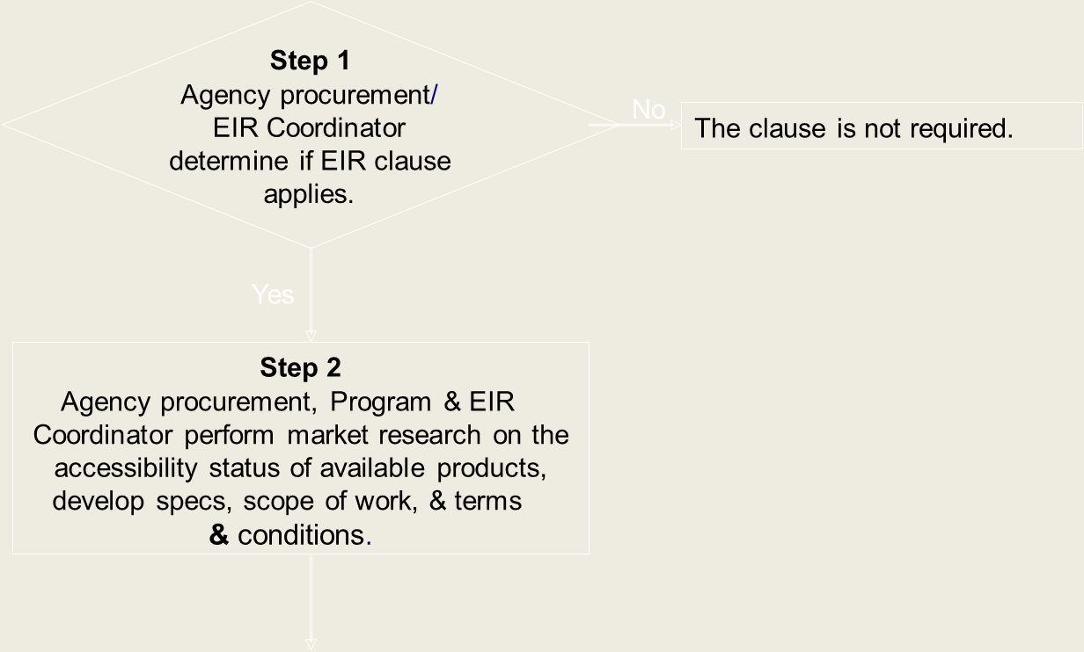
Recommended Business Process, Steps 1 & 2
The actual process may vary among agencies and departments. Regard this as a generic method.
Notes:
In Steps 1 and 2, “Agency procurement” must be deleted and replaced by “procurement team.”
Before reading Step 1: The actual process may vary among agencies and departments. Regard this as a generic method.
After reading Step 2: This may include acquiring and reviewing potential supplier VPATs during market research, determining accurate accessibility compliance, and including accessibility compliance criteria in developing the specs, scope of work, and terms and conditions.

Slide 20
Recommended Business Process, Steps 3-5
Step 3
include the
accessibility requirements in
the solicitation document.
Step 4
route the solicitation
for internal agency review,
comments & approval.
Step 5
submit purchase
request & initiate
solicitation.
Notes:
In steps 3-5, insert “procurement team” instead of ECPS.
After reading Step 3: Consider the relative importance of accessibility compliance in the context of the procured product or service. Include VPAT documentation requests in the solicitation document.

Slide 21
Recommended Business Process, Steps 6-8
Step 6
group (including the
EIR Coordinator) evaluates the
vendor responses.
Agency procurement/EIR Coordinator:
▪
Initiate accessibility exception process.
Step 7
▪
Obtain formal accessibility remediation plan from
Is the tentative
No
supplier including a planned compliance date.
contract winner
▪
Develop plan for alternative access methods
accessibility
(Agency and/or Supplier).
compliant?
Yes
Step 8
ECPS awards the contract
Notes:
Step 6: Change “ECPS” to “procurement team.”
Step 7: Change to: “Is the selected contract award winner’s product accessible?”
In the “No” alternative, change “Agency procurement” to “procurement team.”
Step 8: Change: “ECPS” to “procurement team.”
After reading Step 6: Review for validity. Perform solution accessibility testing to validate documentation (VPAT) provided. For noncompliant bid responses, assess the agency risk of deploying a noncompliant solution and make a request to the supplier for an accessibility remediation plan that includes a planned compliance date. Identify and recommend the best solution for accessibility compliance to the program.

Slide 22
Recommended Business Process, Step 9
Step 9
Agency procurement/EIR
Coordinator implement the
contract.
Step 10
Agency procurement controls the
contract life cycle and
maintenance.
Notes:
Edit Step 9 and Step 10 boxes to delete “agency procurement” and insert “procurement team.”
After reading Step 9: Implementation includes receipt, installation, final accessibility validation in the agency’s environment (test servers, etc.), and solution maintenance.
Take step 10 off this slide and make it into its own slide.
After reading Step 10: Include Accessibility in contract oversight process (COS) by performing additional testing for solution upgrades or maintenance as needed, monitor for quality control and necessary corrective actions, monitor contract changes to ensure that EIR accessibility compliance is maintained, review or dispute invoices for noncompliant billings, and reassess accessibility compliance status, and plans before contract renewal.
Before moving to the next slide: For your reference, there is a handout of this flowchart, all on one page, in your packet.

Slide 23
EIR Accessibility Requirements in Solicitations
Language should be included in EIR-related solicitation stating that :
Vendor products must conform to all applicable EIR standards. This applies to all EIR developed and procured.
Vendors must include an acceptable form of documentation in their bid responses. An example is a Voluntary Product Accessibility Template (VPAT).
You may require the opportunity to test the product for accessibility before completing the purchase.
Notes:
After 2nd bullet: VPAT’s will be covered on the next few slides.
Ron does the next slide:

Slide 24
What is a VPAT?
A VPAT is
an industry disclosure statement
a vendor-generated, product-specific statement that provides relevant and specific information about compliance with Section 508 standards
a tool to help staff make preliminary assessments of the accessibility compliance in a vendor’s EIR
a way for staff to evaluate accessibility compliance consistently across multiple vendors
Notes:
Read before reading the slide:
Because the vast majority of our IT procurements are made through DIR contracts, it is very important that I stress that DIR does not comply with the accessibility requirements up front. Vendors and their products listed on the DIR approved vendor list may or may not be accessible. That information is not disclosed, it is up to us to contact the vendor for that information. A starting point is through requesting the VPAT.
Read the slide.
Ron does the next slide:

Slide 25
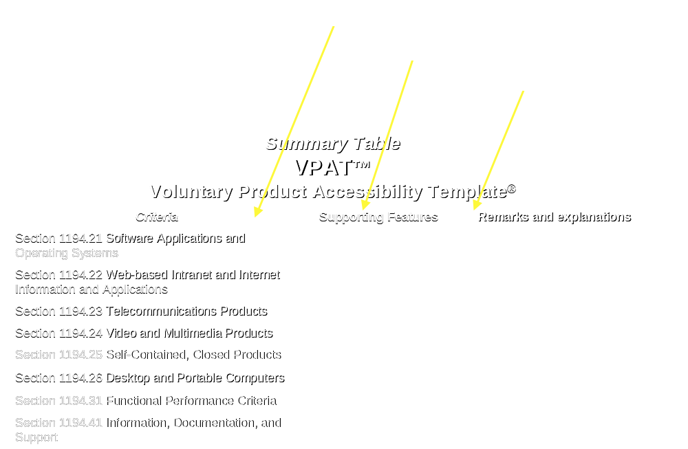
Analyzing the VPAT
Notes:
This is a blank shell of the template. The date, product name and contact information is listed at the top. The left column lists the section 508 criteria reference. Vendors will list the degree of compliance to each section 508 reference in the middle column and any additional remarks and explanations in the right column.

Slide 26

Analyzing the VPAT, cont’d.
Work with the agency’s accessibility coordinator when purchasing EIR. VPATs may contain inaccurate or misleading information; you can talk with the vendor to clarify issues that may be in question.
Red Flags:
    the use of N/A (not applicable) in areas of the VPAT criteria that are known to be applicable
    global, nonspecific accessibility statements
    “supported with exceptions”
    very long “remarks” on minor exceptions
    no VPAT available
Notes:
[Hand out VPAT examples]
Scenario 1 is the questionable VPAT. Pull out your handout titled “Microsoft Office Outlook 2010 VPAT Example.” Read the bold print on the first two pages and then point out that the rest of the template supporting features are listed as not applicable. With this VPAT lacking so much information, the product may be rejected with out testing.
Scenario 2 is the reasonably credible VPAT. Look at the handout titled “Oracle VPAT Example.” You will notice that more supporting features and remarks are filled in, however many statements are simply repeated. Testing should be done on the product before a contract is awarded to ensure it will meet the needs of the customer.
Scenario 3 is the credible VPAT. Look at the “IBM TIBVOLI Asset Manager VPAT Example.” You will notice they give detailed remarks about what is accessible and what is not. Testing should be done on the product to confirm the VPAT claims before a contract is awarded.

Slide 27
Vendors’ roles and responsibilities
In response to an agency request or a DIR Cooperative Contract enrollment, the vendor is required to provide accurate and detailed information about the accessibility of products and services offered through a VPAT(s).
Vendors are responsible for accurately representing the accessibility of their products. Failure to do so may result your exercising any and all remedies available under state law.
Vendors are responsible for ensuring that they, their developers, and other relevant employees are available to state agencies to correct accessibility deficiencies not addressed in the VPAT(s).

Slide 28
EIR Exception Process
Threshold of risk:
The agency’s threshold refers to the agency’s comfort level of risk. In this instance, “risk” means the risk of not meeting an employee or client’s need, the risk of receiving a complaint, and the risk of being sued.
Exception form:
If the purchase does not comply with state agency policy, an exception form must be submitted through the EIR accessibility coordinator before the final contract is awarded. Include any exception in the final contract document. [See note below]
Non-elimination of risks:
The EIR accessibility exception does not eliminate the risks associated with non-accessible EIR and the responsibility to provide an accessible solution.
Notes:
Note: Question: Does the EIR accessibility coordinator generate the exception form, or does someone else generate it and submit it to the accessibility coordinator?
Risk may be determined by the following:
Is it available to employees and public?
Is it available to employees only?
Is it mission critical?
How many users?
Does this exist for historical purposes only?
Is this something created or procured on or after September 1, 2006?

Slide 29
EIR Exception Process, cont’d.
The EIR accessibility exception:
  must provide solid justification for purchasing non-accessible EIR
    non-availability of accessible products
    fundamental alteration required to make accessible
    cost prohibitive to make EIR accessible
  must include an “alternate means of access”
  must be signed by the agency commissioner
Examples of exception forms are available in the state agency EIR Accessibility Policy Manual (http://hhscx.hhsc.state.tx.us/EIR/) or on the HHSC forms website, listed as HHSC_570 (http://hhsc-online.hhsc.state.tx.us/handbook/forms.asp).
Notes:
This was the original wording at the bottom of the slide:
“The Exception Request Form HHS570 can be found in the HHS EIR Accessibility Policy Manual (http://hhscx.hhsc.state.tx.us/EIR/) or on the HHSC Forms Website, listed as HHSC_570 (http://hhsc-online.hhsc.state.tx.us/handbook/forms.asp).”

Slide 30
Resources for Further Learning
HHSC (Health & Human Services Commission) Accessibility Center for EIR (http://architecture.hhsc.state.tx.us/myweb/Accessibility/index.asp )
Procurement FAQ (http://architecture.hhsc.state.tx.us/myweb/Accessibility/docs/procurementFAQ.doc )
VPAT Template (http://architecture.hhsc.state.tx.us/myweb/Accessibility/procurement.asp )
a blank VPAT can be found on the ECPS Intranet Site (http://hhscx.hhsc.state.tx.us/Admin/purch/forms.shtml)
Notes:
After reading the slide: Let’s review the discussion questions handout.
When discussion is over: You can use the cheat sheet provided titled “EIR Contract Clause Applicability” for reference.
Other useful handouts for quick reference are the list of EIR Accessibility Coordinators and the procurement FAQ’s sheet.

Slide 31
Thank you!
Contact Information
Ron Lucey, Manager DARS” Center for Policy & External Relations 512-377-0577
Adrian Roel Pineda, CTCM, CTPM, QMHP, Accessibility Specialist, Center for Policy & External Relations 512-377-0639
accessibility@dars.state.tx.us

